Slide 1
FRANCESCO SEBASTIANO MEMMOLA
50893A

Slide 2
Variables descriptions
NA000334Q Quarterly U.S. nominal GDP
GDPDEF GDP Quarterly GDP price index (2017=100) deflator (base = 100)
B230RC0Q173SBEA Quarterly U.S. population

Slide 3
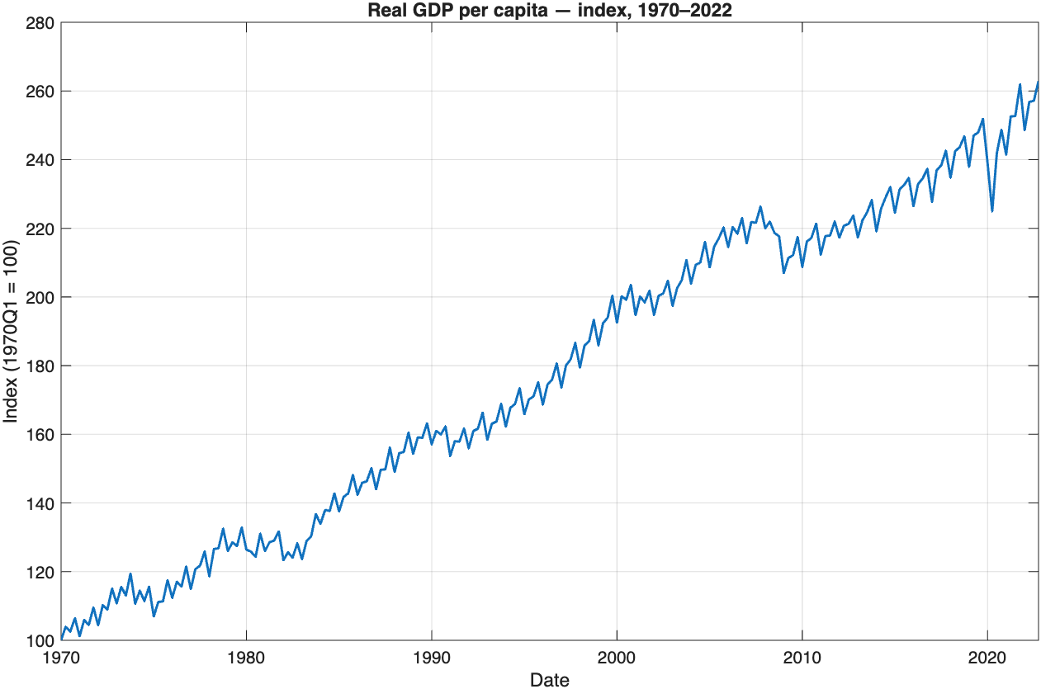
Real GDP per capita
A strong long-run uptrend (≈2.6× since 1970) with brief downturns in the early-1980s, 2008–09, and 2020, followed by rebounds to new highs by 2022 after covid.

Slide 4
∆rgdppc_{t}
Avg annualized per-capita real GDP growth (1970–2022): 1.83%

Slide 5
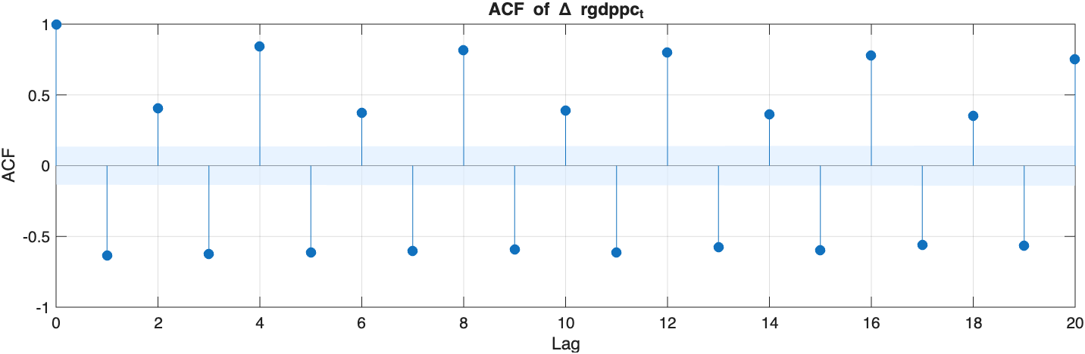
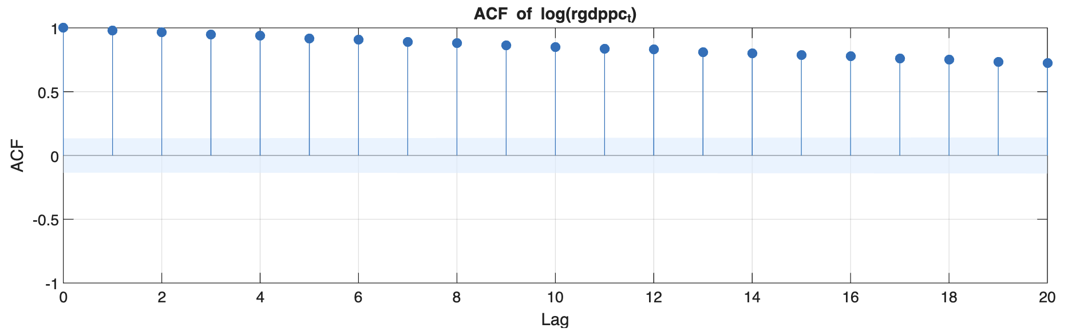
The ACF of GDP growth rates shows low persistence with alternating positive and negative spikes, suggesting little autocorrelation.
In contrast, the ACF of the logarithm shows strong, slowly decaying correlations, indicating strong trend persistence.

Slide 6
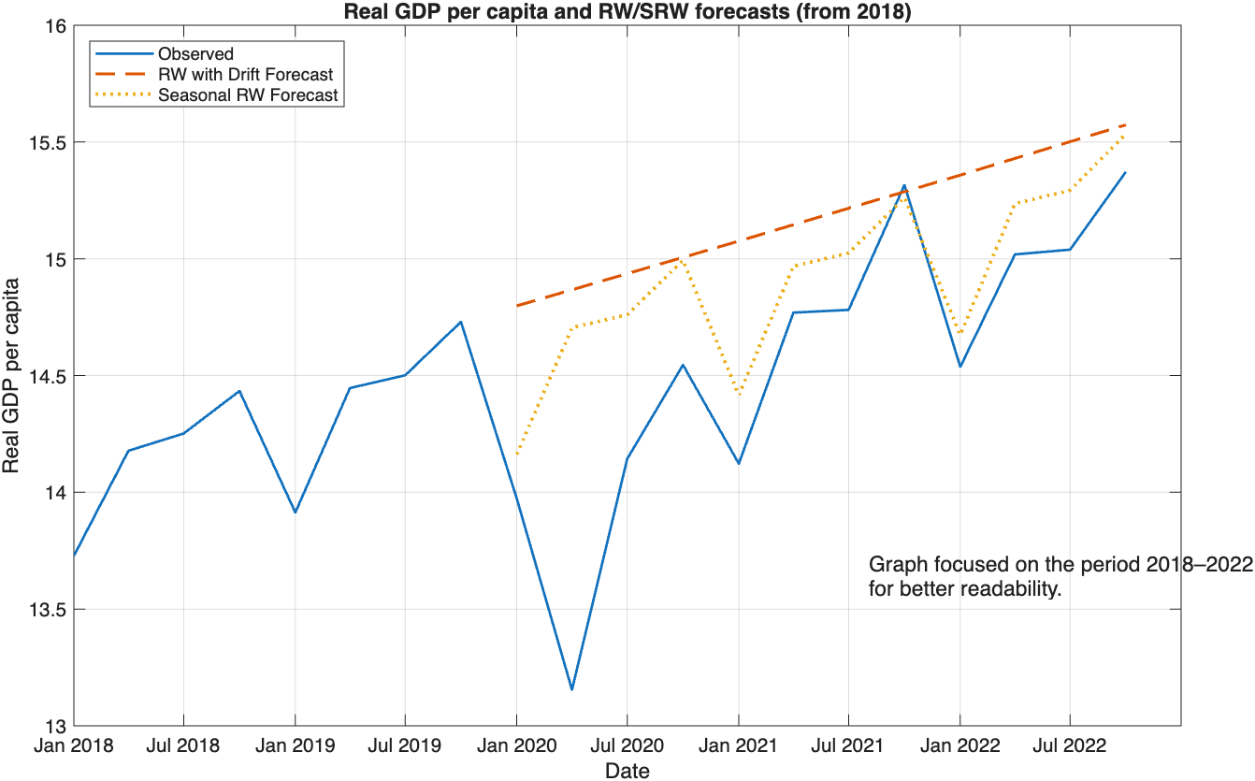

Slide 7
